Slide 1

DEVELOPMENT OF B2C MESSAGE PROPAGATION STRATEGIES FOR UTILITY MAXIMIZATION IN SOCIAL NETWORKS Review Meeting 6
PRESENTED BY SUPERVISOR
D.PUNITHA, AP(O.G) Dr. S.PRASANNA DEVI,
Department of CSE Professor & Head , Dept. of CSE
SRMIST, VDP campus SRMIST, VDP Campus

Slide 2
COURSE WORK DETAILS
SUBJECT CODE | DEPARTMENT OFFERING COURSE | SUBJECT TITTLE
RME001 | MBA | RESEARCH METHODOLOGY
DA2112 | M.Tech(IT)-Big Data Analytics(Elective Paper) | DEEP LEARNING
DA2108 | M.Tech(IT)-Big Data Analytics(Elective Paper) | SOCIAL NETWORK ANALYSIS
DA2107 | M.Tech(IT)-Big Data Analytics(Elective Paper) | WEB INTELLIGENCE & BIG DATA ANALYTICS
GRADE
A
A+
B
A
Completed Comprehensive Viva on 07.01.2021

Slide 3
Status Of Research Work Short Term Goals
Task Assigned | STATUS
Comprehensive Viva | Completed (7.01.2021)
Module 1 Implementation | Completed
Scopus Publication | Got Acceptance
Module 2 Implementation | Completed

Slide 4
RESEARCH GAP
To identify seed node for transmission of messages based on fitness of each node
To ensure truthfulness in message diffusion
To give reward only for truthful seed node
To achieve Nash equilibrium between seller and identified seed node

Slide 5
PROBLEM DEFINITION
Consumer Satisfaction
Customized Message Propagation
Truthfulness of influenced node
Optimized Win-Win Strategy
Seed Selection
Seller capacity truthfulness
Viral Marketing
Budget based message propagation

Slide 6
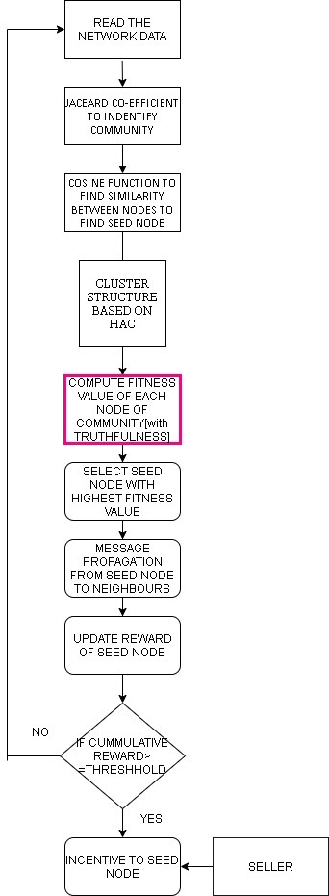
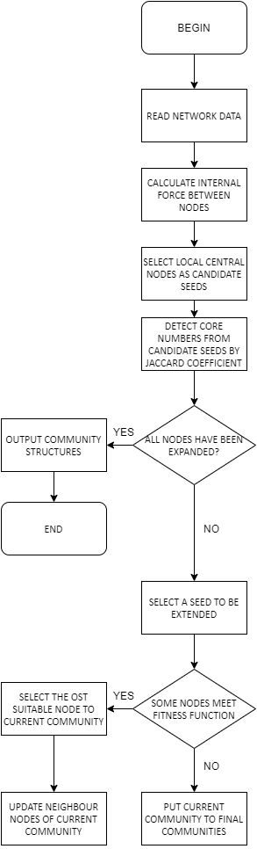
EXISTING & PROPOSED WORK FLOW

Slide 7
PROPOSED WORK MODULE
Module 1: Fitness propagation and selection of seed node for message diffusion in social networks (without truthfulness)
Module 2: : Fitness propagation and selection of seed node for message diffusion in social networks (considering the truthfulness of the participating nodes) and achieving Nash Equilibrium
Module 3: Learn the truthfulness and capabilities of a community cluster to optimize influence maximization in viral marketing

Slide 8

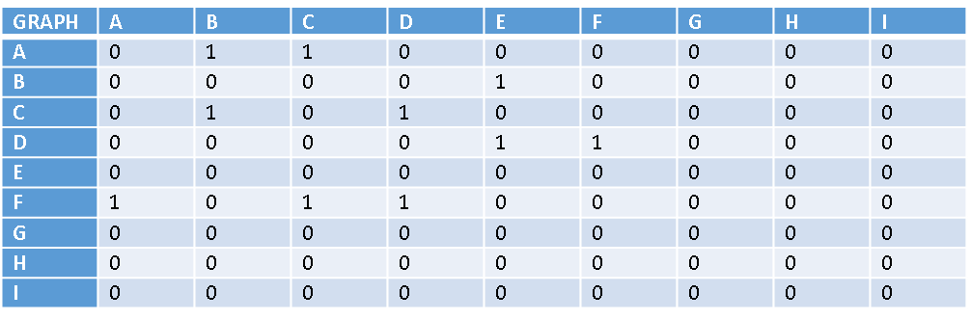
OBJECTIVE 1 Fitness propagation and selection of seed node for message diffusion in social networks (without truthfulness)
Input Graph
Cluster Output
E F
B C D A
Cosine function to find the similarity between nodes
Cos(x, y) = x . y / ||x|| * ||y||
x . y = product (dot) of the vectors ‘x’ and ‘y’.
||x|| and ||y|| = length of the two vectors ‘x’ and ‘y’.
||x|| * ||y|| = cross product of the two vectors ‘x’ and ‘y’.

Slide 9

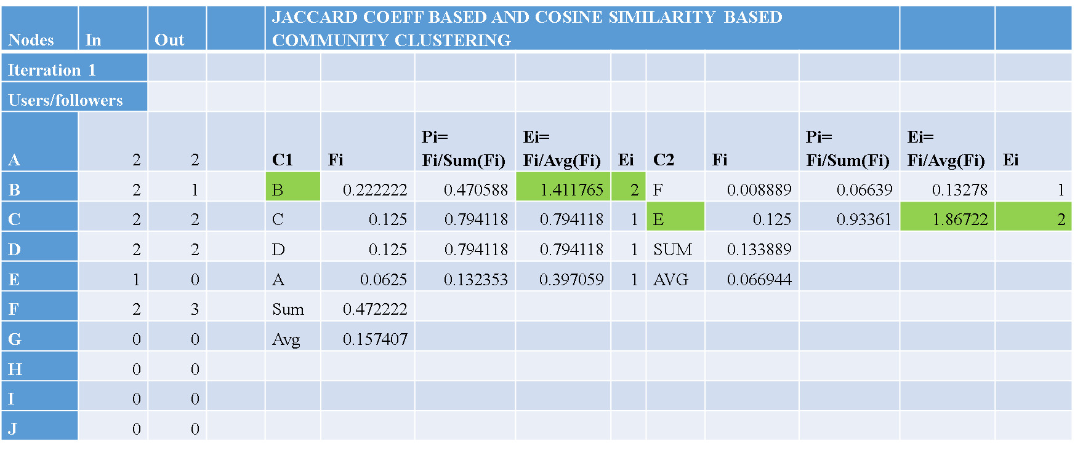
OBJECTIVE 1 Fitness propagation and selection of seed node for message diffusion in social networks (without truthfulness)
Fitness function to select seed node
F_{i}= f_{in} ∕ ( f_{in}+ f_{out})²
f_{in -} no of incoming edges of node
f _{out -} No of outgoing edges of node

Slide 10

OBJECTIVE 1 Fitness propagation and selection of seed node for message diffusion in social networks (without truthfulness)
Output of seed node selection using dataset
Iteration 1
Iteration 2
Nodes | Fin | Fout | Fi | Pi | Ei
B | 2 | 2 | 0.125 | 0.074528 | 0.447168
C | 2 | 1 | 0.222222 | 0.132494 | 0.794965
D | 2 | 2 | 0.125 | 0.074528 | 0.447168
A | 2 | 2 | 0.125 | 0.074528 | 0.447168
E | 1 | 0 | 1 | 0.596224 | 3.577343
F | 2 | 3 | 0.08 | 0.047698 | 0.286187
Nodes | Fin | Fout | Fi | Pi | Ei
C | 4 | 1 | 0.16 | 0.110337 | 0.993037
D | 5 | 2 | 0.102041 | 0.070368 | 0.633315
I | 2 | 2 | 0.125 | 0.086201 | 0.775811
F | 3 | 2 | 0.12 | 0.082753 | 0.744778
B | 3 | 0 | 0.333333 | 0.22987 | 2.068828
G | 2 | 3 | 0.08 | 0.055169 | 0.496519
H | 3 | 2 | 0.12 | 0.082753 | 0.744778
E | 2 | 1 | 0.222222 | 0.153247 | 1.379219
A | 3 | 1 | 0.1875 | 0.129302 | 1.163716

Slide 11
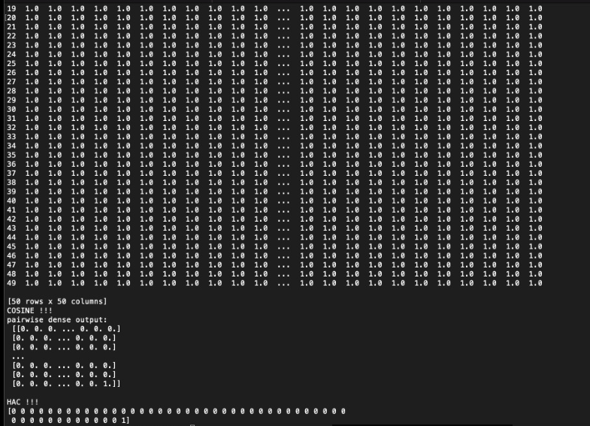
Cosine Similarity Calculation

Slide 12
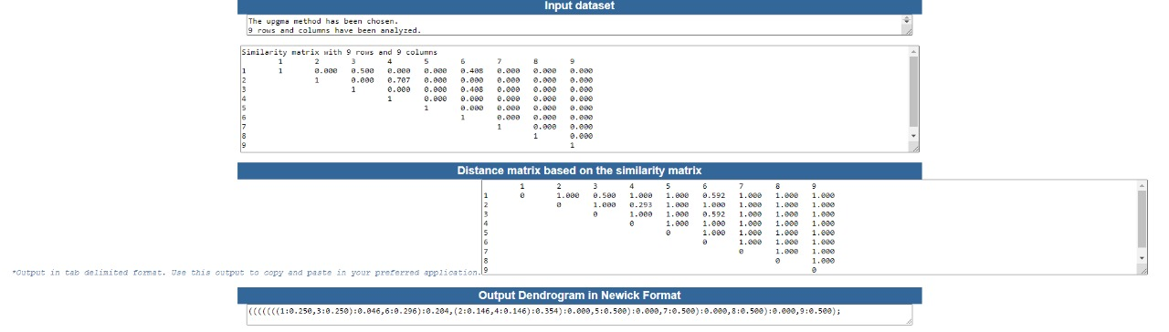
Hierarchical Agglomerative Clustering

Slide 13
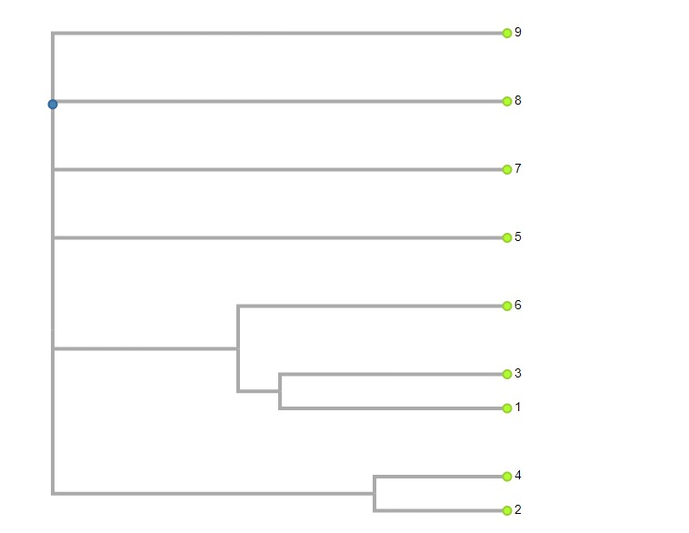
Hierarchical Agglomerative Clustering
1 2 3 4 5 6 7 8 9

Slide 14
OBJECTIVE 2 Fitness propagation and selection of seed node for message diffusion in social networks (considering the truthfulness of the participating nodes)
Fitness function to select seed node based on truthfulness
F_{i}=∑ _{i=1}w_{i}. f_{in} ∕ (f_{in}+ f_{out})²
w_{i -} Edge weight of trusted message propagation
Expected Value of each node for extension, Ei
E_{i}= Fi/Avg(Fi)
F_{i} – Fitness function
Seed node Output with Trust

Slide 15

OBJECTIVE 2 Fitness propagation and selection of seed node for message diffusion in social networks (considering the truthfulness of the participating nodes)
Output of seed node selection using dataset
Fitness Function:
The fitness function with internal force is used to measure the tightness of a group of nodes.
Nodes | Fin | Fout | Fi | t | c | T | h | Pi | Ei-without trust | Wi | Ei_withTrust
1 | 0 | 347 | 0 | 3/27/2016 0:53 | 0 | 0.5 | 1 | 0 | 0.0 | 1.5 | 0.00
2 | 1 | 16 | 0.00346 | 4/4/2016 1:39 | 0 | 0.5 | 1 | 1.36E-05 | 0.1 | 0.5 | 0.00
3 | 1 | 9 | 0.01 | 3/13/2016 20:35 | 0 | 0.5 | 0 | 3.93E-05 | 0.2 | 1.5 | 0.02
4 | 1 | 16 | 0.00346 | 1/10/2016 2:31 | 0 | 0.5 | 1 | 1.36E-05 | 0.1 | 0.5 | 0.00
5 | 1 | 9 | 0.01 | 6/3/2016 3:36 | 0 | 0.5 | 0 | 3.93E-05 | 0.2 | 1.5 | 0.02
6 | 1 | 12 | 0.005917 | 5/19/2016 14:30 | 0 | 0.5 | 1 | 2.33E-05 | 0.1 | 0.5 | 0.00
7 | 1 | 5 | 0.027778 | 1/28/2016 20:59 | 1 | 0.5 | 1 | 0.000109 | 0.4 | 1.5 | 0.04
8 | 1 | 19 | 0.0025 | 3/7/2016 1:40 | 1 | 0.5 | 1 | 9.83E-06 | 0.0 | 0.5 | 0.00
9 | 1 | 7 | 0.015625 | 4/18/2016 9:33 | 0 | 0.5 | 0 | 6.14E-05 | 0.2 | 0.5 | 0.01
Fi ∝ Fin
Fi ∝ 1/ Fout

Slide 16

TIMELINE
year | 2019-2020 |  | 2020-2021 |  | 2021-2022 |  | 2022-2023
Research Target | July-Dec | Jan- Jun | July-Dec | Jan- Jun | July-Dec | Jan- Jun | July-Dec | Jan- Jun
Course Work
Literature Review
Fitness Propagation And Selection Of Seed Node
Reward Update & Nash Equlibrium
Optimize Influence Maximization In Viral Marketing
Open Source Tool
Full Research work Completion
Publication
Synopsis Submission

Slide 17

Publication Details
Paper Title | Authors | Journal/Conference details | Published Date
FITNESS PROPAGATION AND SELECTION OF SEED NODE FOR MESSAGE DIFFUSION IN SOCIAL NETWORKS | D.Punitha, S.Prasanna Devi | Journal of Applied Theoretical and Information Technology | Got Acceptance. Will be published in May

